Slide 1
8th Wizz Air Kyiv City Marathon. 08 October 2017

Slide 2
Wizz Air Kyiv City Marathon 2017
Date: 08, October, 2017
Location: Kiev, Maidan Nezavisimosti
Participants: 11 000
Number of visitors: 25 000
Prize Fund: 146 300 UAH
Number of races and cups: 17
Distance: 42.195 km in one lap
Time limit : 6 hours
Web-site:kyivmarathon.org
Под патронатом:

Slide 3
Wizz Air Kyiv City Marathon 2016
WIZZ AIR KYIV CITY MARATHON 2016 ( watch vodeo)

Slide 4
Wizz Air Kyiv City Marathon
2017
Offers for international participants

Slide 5
Races
INDIVIDUALS
NEW RACES
RELAY
Classic
3х10 km + 1х12.195 km
42,195 km
NEW Security Cup 5km
NEW Guide Run 5 km
NEW Family run 2 km
NEW Chamber Cup 3х10 km + 1х12.195 km
21,0975 km
NEW University Cup 2 km
10 km
NEW Handbikes Run 2 km
NEW Diplomat Cup 3х10 km + 1х12.195 km
5 km
NEW Herbalife run - 1 km
CHILD RACES
2 km
1000 m
500 m
Total races and cups: 17
100 m

Slide 6
Main race
Distance 42,195 km in one lap
Participants could enjoy interesting route through the main tourist attractions in Kyiv: Khreshchatyk, the Kyiv-Pechersk Lavra, the Paton Bridge over Dnipro River, Kyiv Sofia Cathedral and much more
Start and Finish points are in Maidan Nezavisimosti square
Time limit of the marathon race: 6 hours

Slide 7
Entry Fee
Individual Races
42, 195 km | 26 Euro
21,0975 km | 24 Euro
10 km | 13 Euro
Child races
1000 m | free
500 m | free
100 m | free
Relays
Relay (3х10km +1х12 km) | 107 Euro
Chamber Cup Relay (3х10km+1х12 km) | 200 Euro
*Discounts for registration for groups and running clubs

Slide 8
Special offers for international participants:
15% Discount for Entry fee for all international running club members
10% Discount for Entry fee for group requests from 4 members
20 Euro Voucher from Wizz Air company
Special price for accommodation packages

Slide 9
Starter’s package includes:
participant race bib number
results capturing electronic chip
plastic backpack
changing rooms and lockers (changing rooms work from 7:00 to 17:00, October 8)
hydration station: 5, 10, 15, 21, 25, 27.5, 30, 32.5, 35, 37.5, 40 km and at the finish line
online diploma with the race result
route map
«Wizz Air Kyiv City Marathon» Participant’s Guide
special offers from our partners
music on the course
official event wristband
finisher’s package: apple, banana, water
pictures after the race
access to free outdoor trainings “Open run day”
access to exhibition of sporting goods “SportExpoUA 2017” October 6-7

Slide 10
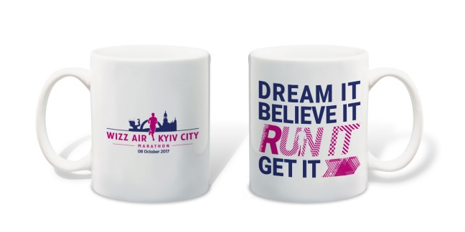
Additional options:
T-shirt with an official logo
23 Euro
Medal engraving 7 Euro
Cups with logo
4,5 Euro
Medical Insurance
6,5 euro

Slide 11
Events and activities for participants

Slide 12
Breakfast run
Date: 7 October, 2017
Conception: fun race of participants with flags from their own countries
After-run Breakfast with coffee and croissants
Police escort during the race

Slide 13
SportExpoUA 2017
Date: 6-7 October, 2017
Location: 40b Pobedy ave., Pushkina Park
Hours of SportExpoUA2017:
October 6, 2017 (Friday): 12:00 p.m. – 08:00 p.m.
October 7, 2017 (Saturday): 10:00 a.m. – 08:00 p.m.
Sport Fest UA - sport expo, where participants could receive starter package, buy sport merchandise, attend lectures and more.
More than 15 000 visitors
More information http://www.sportexpo.com.ua/

Slide 14
ACCOMMODATION
PACKAGES

Slide 15
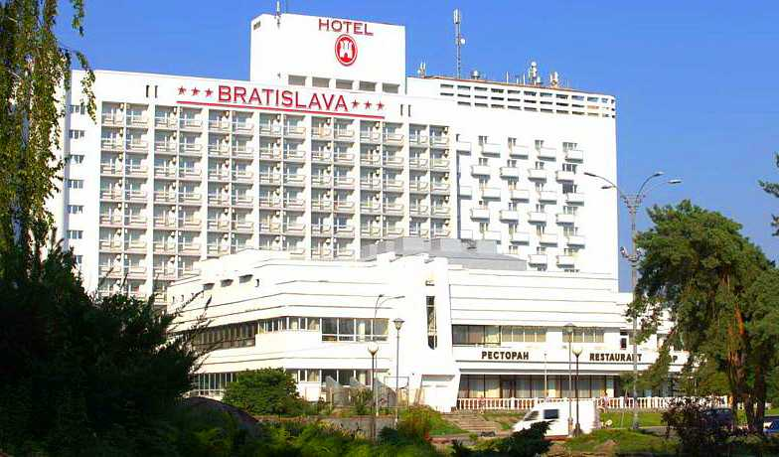
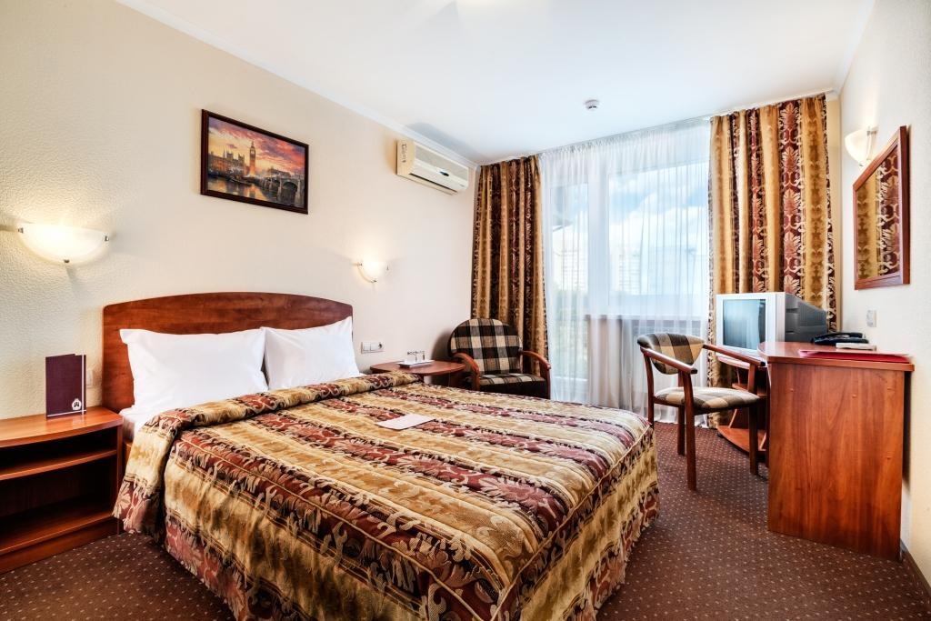
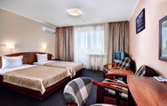
HOTELS 3*
Bratislava 3*
Price per person in room for 1 night
SINGL room 29 euro
TWIN room 21 euro
Package includes:
1 night in hotel
breakfast
*Discounts for groups from 10 pax
Hotel web-site

Slide 16
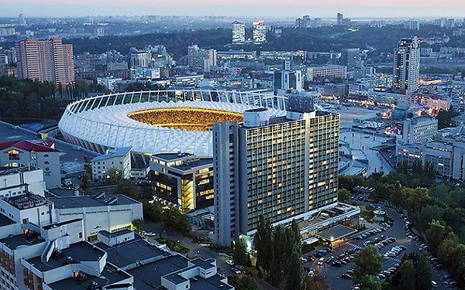
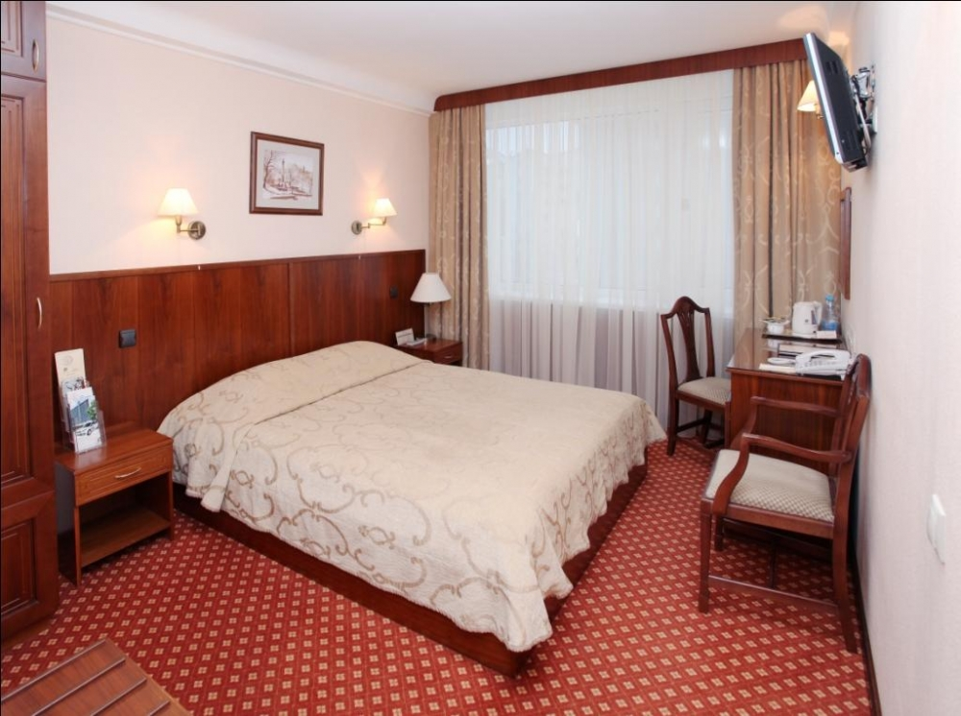
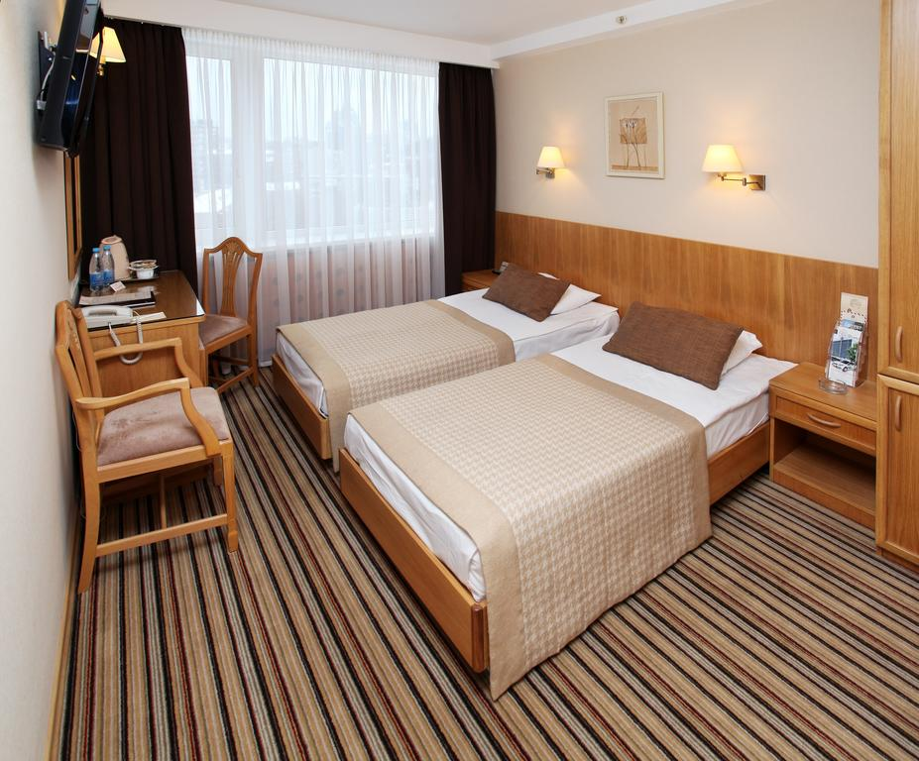
HOTELS 3*
Premier Hotel Rus 3*
Price per person in room for 1 night
SINGL room 45 euro
TWIN room 27 euro
Package includes:
- 1 night in hotel
- breakfast
*Discounts for groups from 10 pax
Hotel web-site

Slide 17
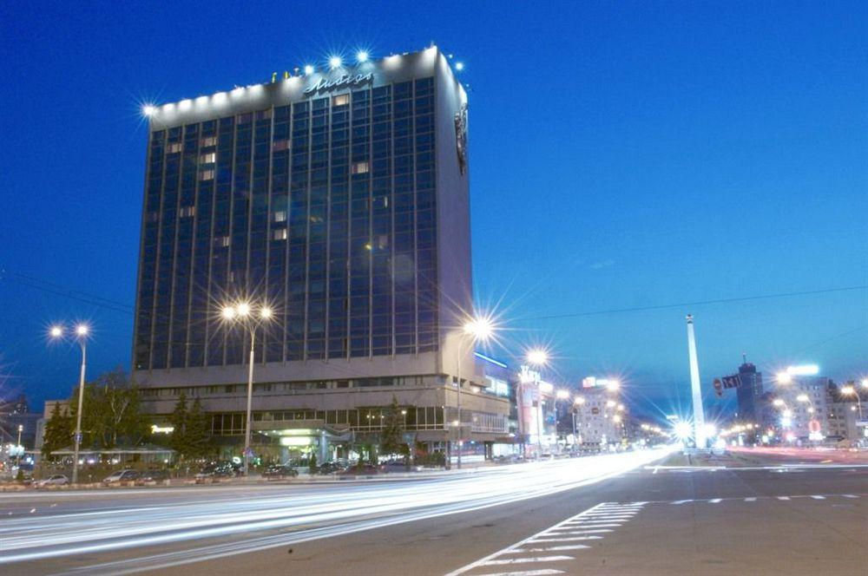
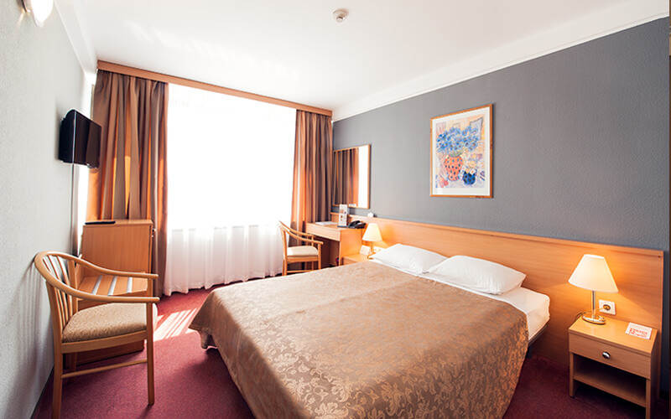
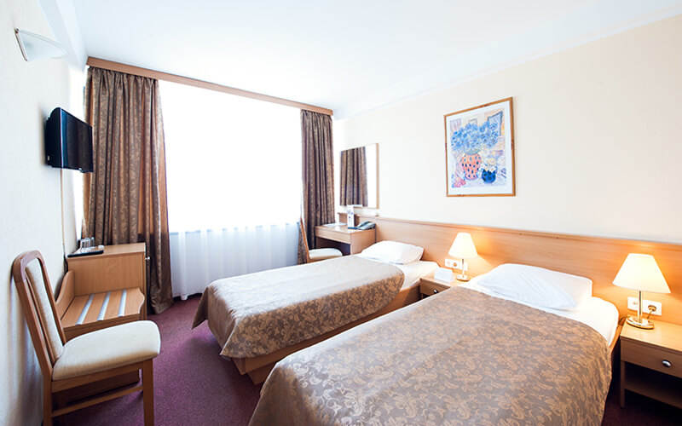
HOTELS 3*
Premier Hotel Lybid 3*
Price per person in room for 1 night
SINGL room 47 euro
TWIN room 27 евро
Package includes:
- 1 night in hotel
Breakfast
*Discounts for groups from 10 pax
Hotel web-site

Slide 18
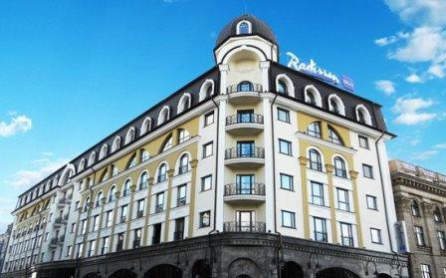
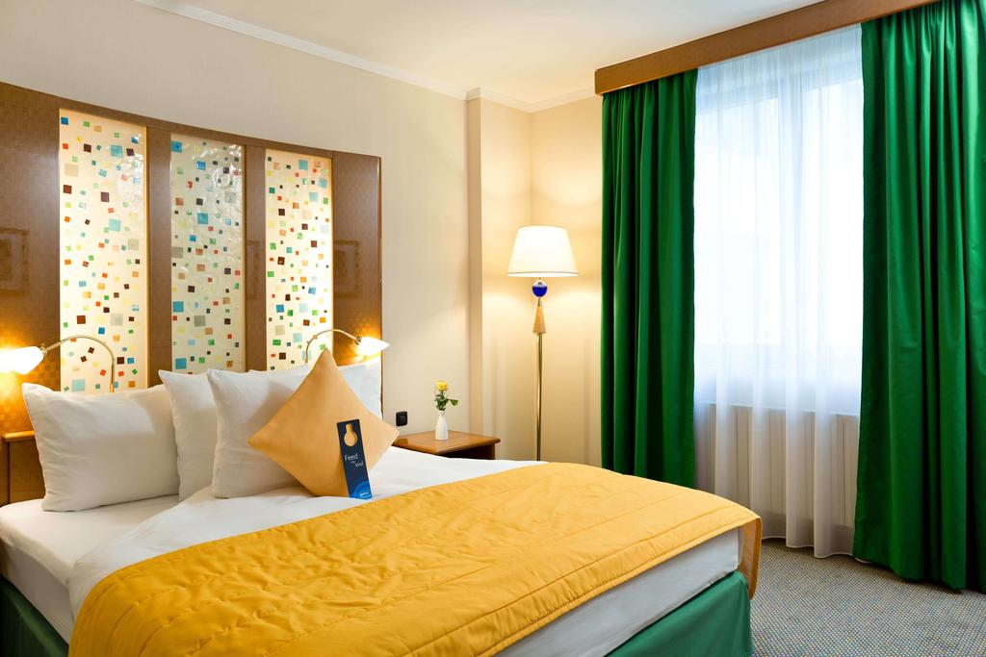
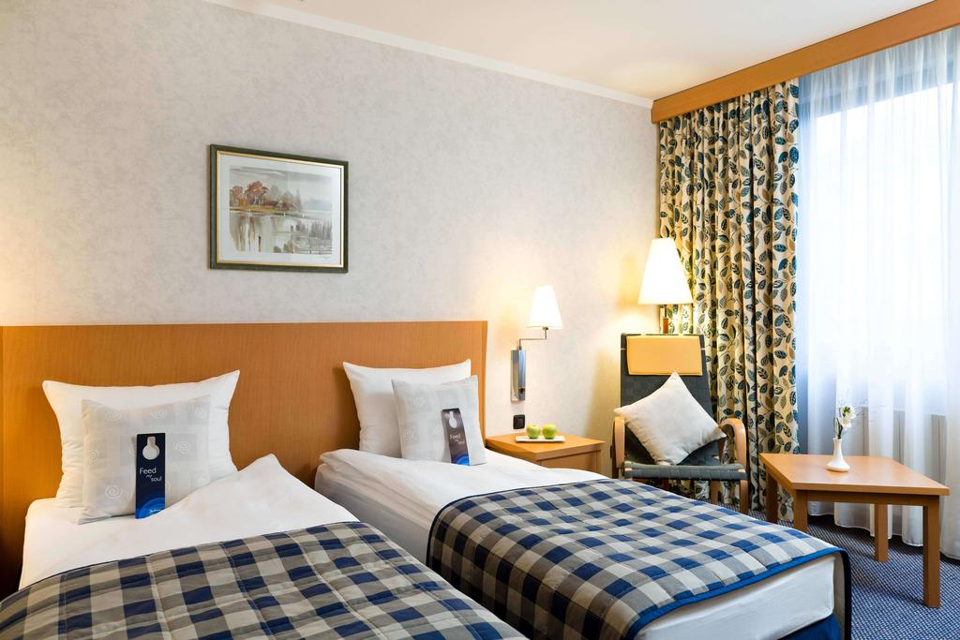
HOTELS 4*
Radisson Blue Hotel 4*
Price per person in room for 1 night
SINGL room 130euro
TWIN room 80 евро
Package includes:
1 nights in hotel
breakfast
*Discounts for groups from 10 pax
Hotel web-site

Slide 19
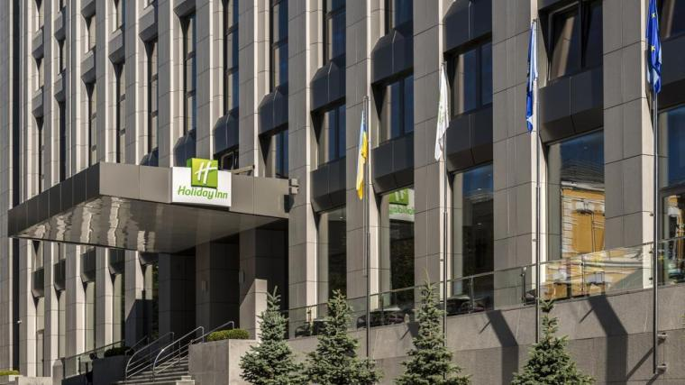
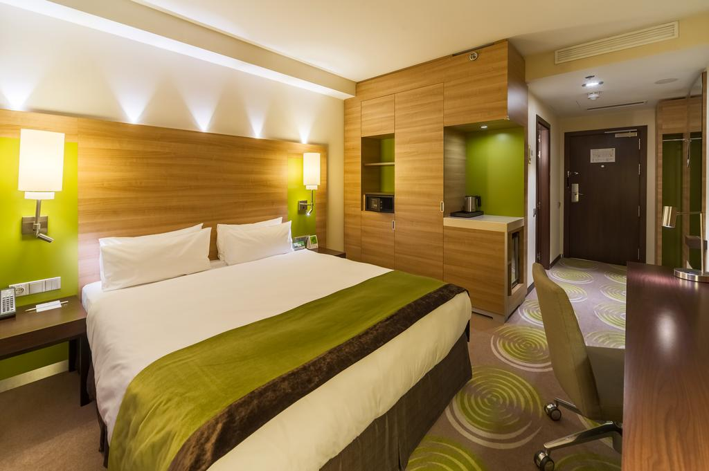
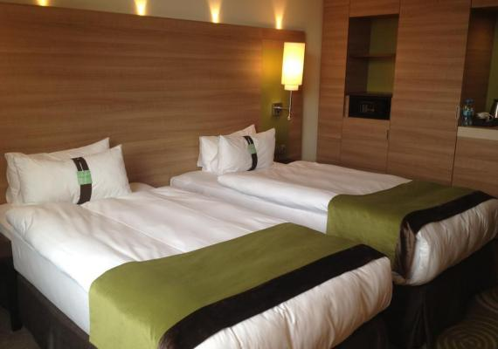
HOTELS 4*
Holiday Inn 4*
Price per person in room for 1 night
SINGL room 125euro
TWIN room 70 евро
Package includes:
- 1 night in hotel
- breakfast
*Discounts for groups from 10 pax
Hotel web-site

Slide 20
About Run Ukraine
Our Mission - promotion of healthy lifestyle and helping ukrainians to become healthy and strong nation
Running for us is social movement that is designed to improve the quality of life and develop society
We develop and improve services so that each participant can feel comfortable and get the maximum pleasure from taking part sport competitions

Slide 21
CONTACT INFORMATION
Run Ukraine - the organizer of Wizz Air Kyiv City Marathon under the patronage of Kyiv City Council and the Athletics Federation of Ukraine
Contact Information:
Ilona Sekevich
Manager of communications with international participants
e-mail: ilona.sekevich@runukraine.org
tel.: +38 066 022 68 19
Official web-site: http://runukraine.org/

